Slide 1
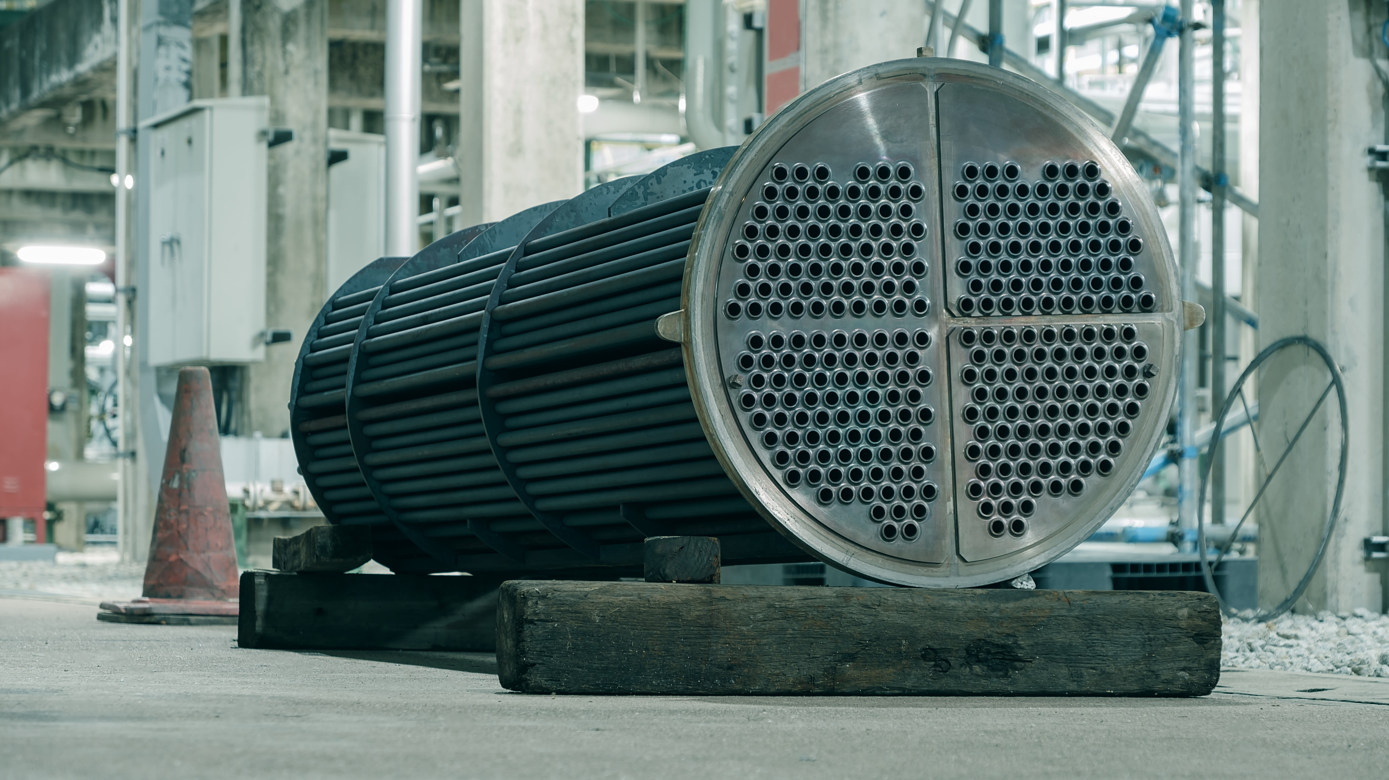
Heat Exchanger Design
Group 1
ABEYWICKRAMA W.M.U. – 220010D
ABINASH A. – 220012K
AFRADH M.M.M. - 220015X
AGALAKADAARACHCHI A.A.A.U - 220016C
ALPITIYA A.K.E.I – 220019M
AMARAWANSHA R.G.A.S.– 220025D
ARUSHAN R.– 220045M
BALASOORIYA C.P.T.M.– 220055T

Slide 2
Contents
Introduction
Key parameters
Calculation
Further modifications
Summary

Slide 3
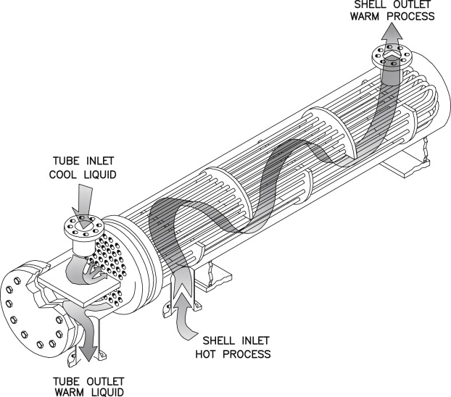
Introduction
1 Shell-2 Pass Heat exchanger
Compact design
Effective heat transfer
Improved temperature control
Cold stream – Crude oil
Hot stream – Gasoline

Slide 4
Key factors to consider
Heat transfer requirements
Fluid properties
Pressure considerations
Space and weight constraints
Material selection
Fouling factors
Flow arrangement
Type of heat exchanger
Environmental considerations
Economic factors (Initial cost)

Slide 5
Calculations

Slide 6
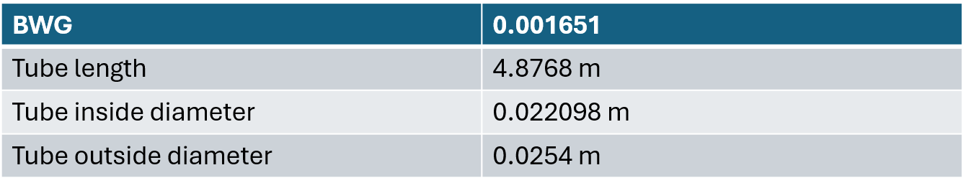

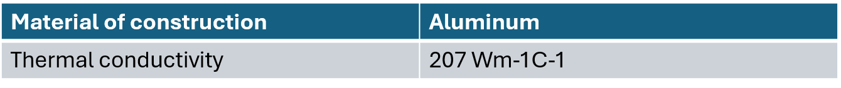
Summary of values assumed in first three steps

Slide 7
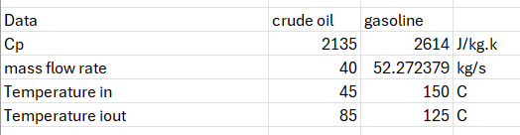
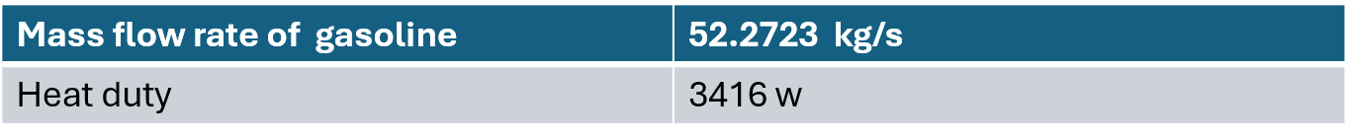
Calculating the heat duty
Temperature of gasoline at the outlet = 105 º C

Slide 8
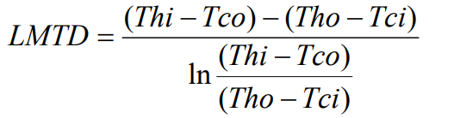
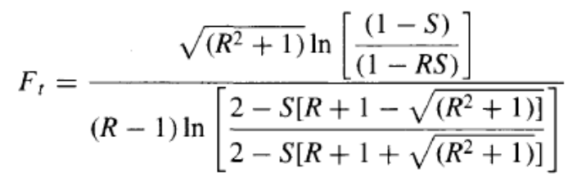
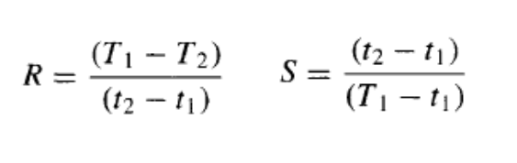
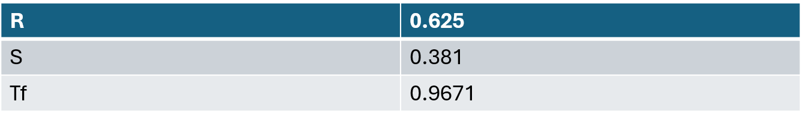
Calculating LMTD value temperature correction correct factor
LMTD = 72.24 ºC

Slide 9



Calculating the mean temperature difference
Calculating the provisional area
Calculating number of tubes
A | 1086.5235 m²
Nt | 2792
Assumed overall heat transfer co-efficient | 45 w/m²K

Slide 10
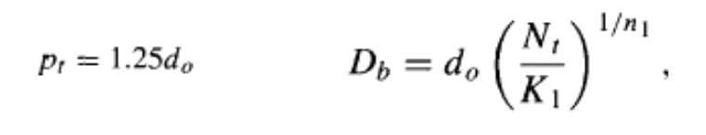
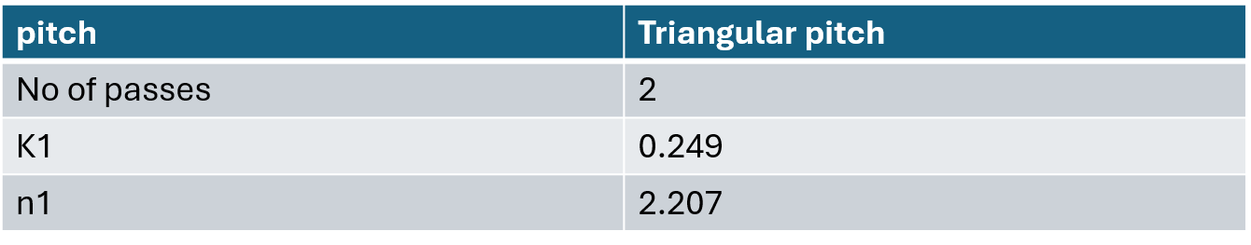

Calculating tube pitch and the bundle diameter

Slide 11



Assumed BDC value: 0.01712
Calculating shell diameter
Calculating baffle spacing
Calculating the area for cross flow

Slide 12
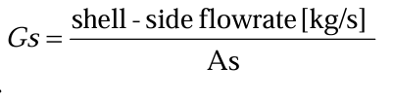
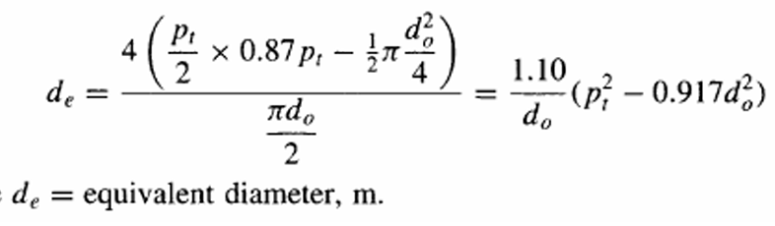
Calculating the shell side heat transfer coefficient
Gasoline is in the shell side
Shell side mass velocity | 212.3749677 kg/ms²
Shell equivalent diameter | 0.01803527m

Slide 13
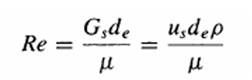

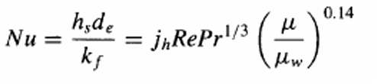
µ of gasoline at 137.5ºC is 0.0003Ns/m²
k of gasoline is 120W/mK
j_{h}(heat transfer factor)is obtained from the chart as 0.006829452
µ_{w} at 150c is 0.00043Ns/m²
Shell-side Reynolds number | 12767.46628
Prandtle number | 0.007
shell-side heat transfer coefficient | 108467.0181W/m²K

Slide 14
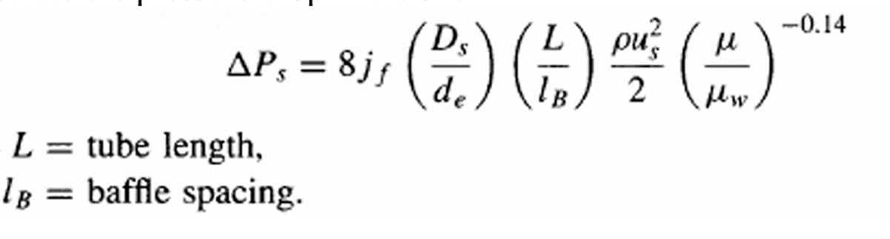
J_{f}(friction factor) is obtained from the chart as 0.047343192
density of gasoline is 654.5 kg/m²
Shell side pressure drop | 9278.02pa

Slide 15
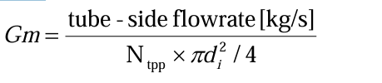
Calculating the tube side heat transfer coefficient
Crude oil is in the tube side
Number of tubes per pass = 1396.017768
Tube-side velocity | 0.086713394m/s²
Tube side mass velocity | 74.7469455kg/ms²

Slide 16

µ of crude oil is 0.00358 N/sm²
Cp of crude oil is 2135 J/kgk
k of crude oil is 0.1385 W/mk
Tube-side Reynolds number | 461.3849167
Prandtle number | 55.18628159
Tube-side heat transfer coefficient | 54.05880617W/m²k

Slide 17
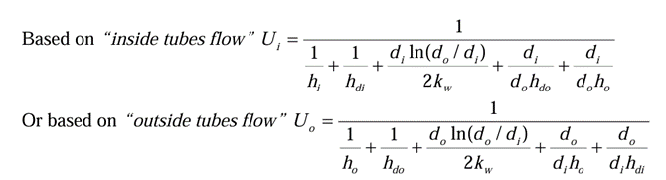
Calculating the overall heat transfer coefficient
Overall heat transfer coefficient based on outside tube flow | 45.207 W/m²k
Tube-side pressure drop | 787981.2244pa

Slide 18
Further modifications

Slide 19
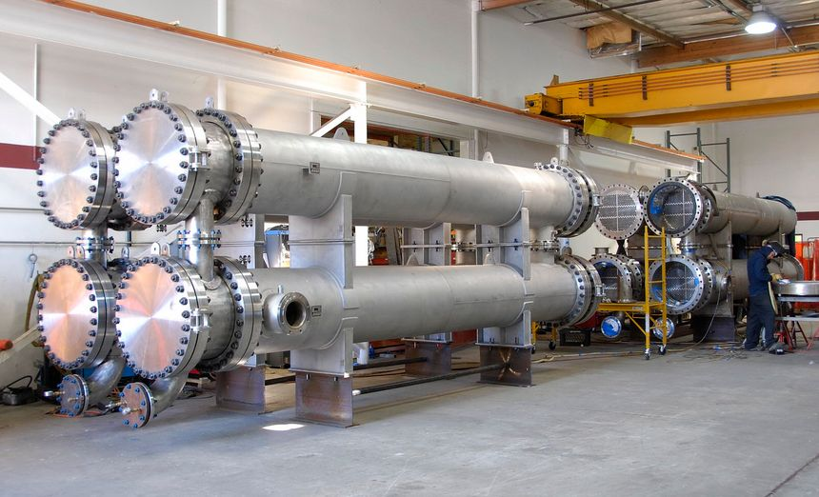
Designing Different Types of Floating Heads
We could explore variations in the floating head design to improve maintenance access and ease of cleaning.
For a shell and double tube heat exchanger, the floating head design is integral to its construction.

Slide 20
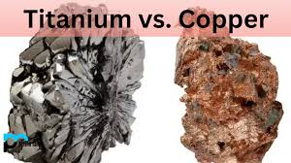
2. Using Alternative Materials for Heat transfer Enhancement
Material selection Should align with our specific application requirements.
Consider using material like copper, stainless steel or titanium instead of aluminum for the tubes to potentially improve heat transfer rates.

Slide 21
3. Considering Corrosion Effects
Corrosion is a key concern for heat exchangers, so materials and coatings should be chosen for their corrosion resistance.
Conduct corrosion studies to assess the impact on the heat exchanger’s longevity.
4. Calculating Optimum Pressure Drop
We can use fluid dynamics and heat transfer software to estimate pressure drops and optimize the design.
Calculating the pressure drop inside a shell and double tube heat exchanger is important for assessing its performance

Slide 22
5. Designing Other Types of Heat Exchangers
While we currently using a shell and double tube heat exchanger, we could explore the possibility of designing other types of shell and tube heat exchangers with different tube configurations, such as multi pass or crossflow designs.

Slide 23
Conclusion
Multiple factors influence the performance of heat exchangers
We can observe varying results by adjusting individual variables, facilitating the optimization of shell and tube heat exchanger designs.
Increasing the thermal conductivity of tube materials leads to improved heat transfer rates.
In the double pipe heat exchangers, utilizing a counterflow configuration results in enhanced heat transfer efficiency.
This conclusion underscores the importance of careful design and material selection in achieving effective heat exchange.

